Slide 1
Online Advertising Performance Analysis
Insights from April - June 2020 Online Advertising Data
By Shaik Riyaz

Slide 2
Mission Statement
Primary Goal: To analyze online advertising data from April to June 2020 to provide actionable insights for optimizing campaign performance and improving Return on Investment (ROI).
Business Impact:
Increase Efficiency and ROI: Focus resources on high-performing ad combinations and placements.
Enable Targeted Efforts: Understand which user segments, banners, and placements are most effective.
Gain a Deeper Understanding: Translate campaign data into a clear strategy for future advertising initiatives.

Slide 3
Understanding the Data & Building a Foundation
Source: Online advertising performance data from April to June 2020.
Key Data Points: Includes metrics like displays, clicks, conversions, revenue, cost, and user engagement segments (High, Medium, Low).
Data Preparation Steps:
Initial Loading & Cleaning: Data was loaded and standardized with columns renamed for clarity.
KPI Engineering: Key performance indicators like CTR, CVR, ROAS, and CPC were computed.

Slide 4
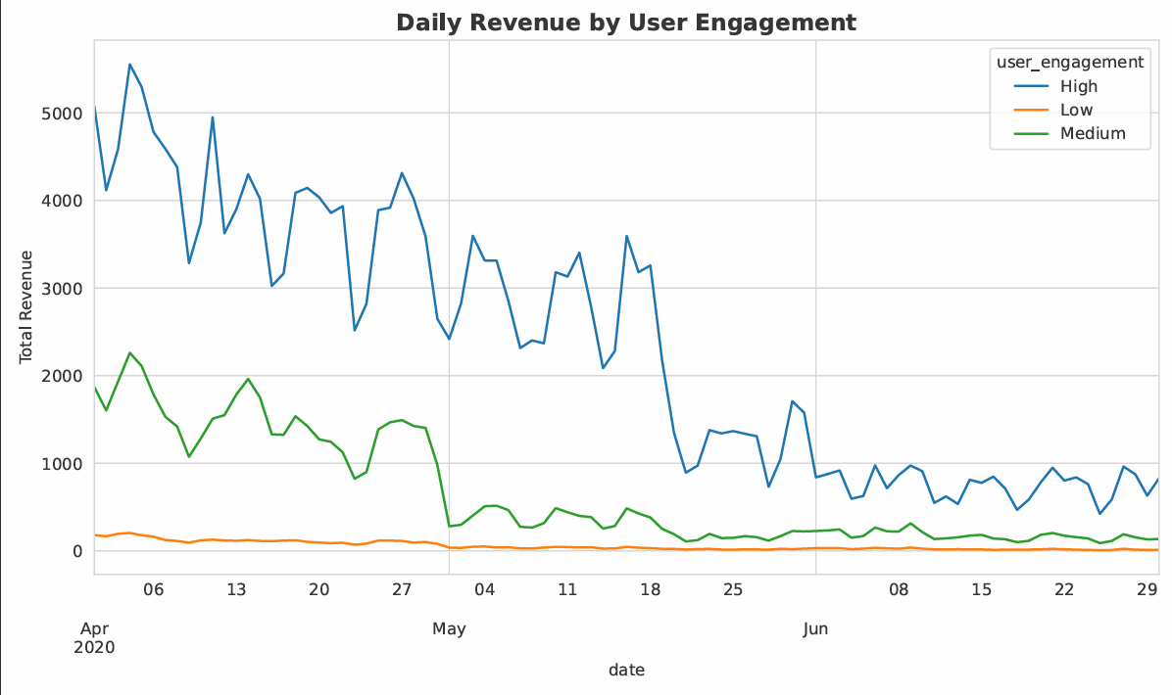
Who Are Our Most Valuable Users? (Revenue Breakdown)
Core Insight: The 'High' user engagement segment is the most valuable, contributing almost 80% of all revenue.
Breakdown:
High Engagement: 76.8% of total revenue.
Medium Engagement: 21.3% of total revenue.
Low Engagement: 1.9% of total revenue.
The 'High' engagement segment consistently drives the most revenue on a daily basis, but revenue from all segments shows fluctuations over time.

Slide 5
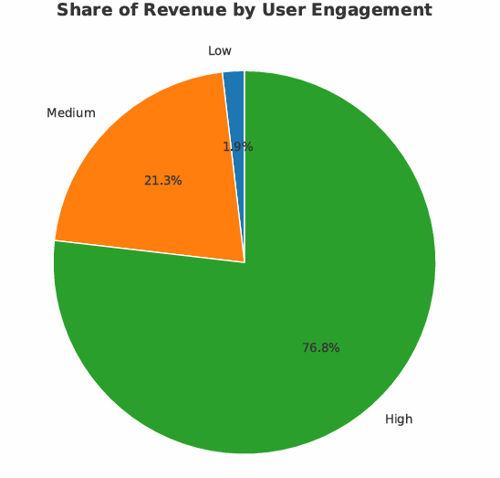
Who Are Our Most Valuable Users? (Revenue Breakdown)

Slide 6
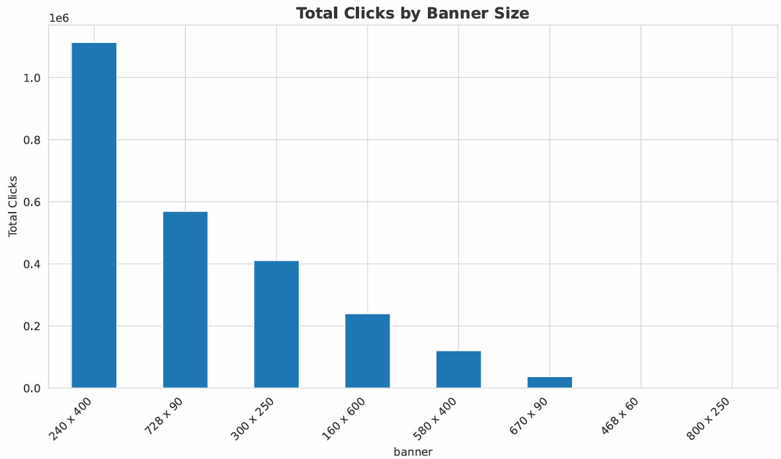
Banners vs. Clicks (What Ad Sizes Get the Most Clicks?)
Core Insight: The 240x400 and 728x90 banners are the most effective at driving clicks.
Breakdown:
Finding: The 240x400 and 728x90 banner sizes generate the highest volume of clicks, making them ideal for driving traffic.
Observation: These two formats are the most effective at capturing user attention and encouraging interaction.
Visualization Used: Bar chart.

Slide 7
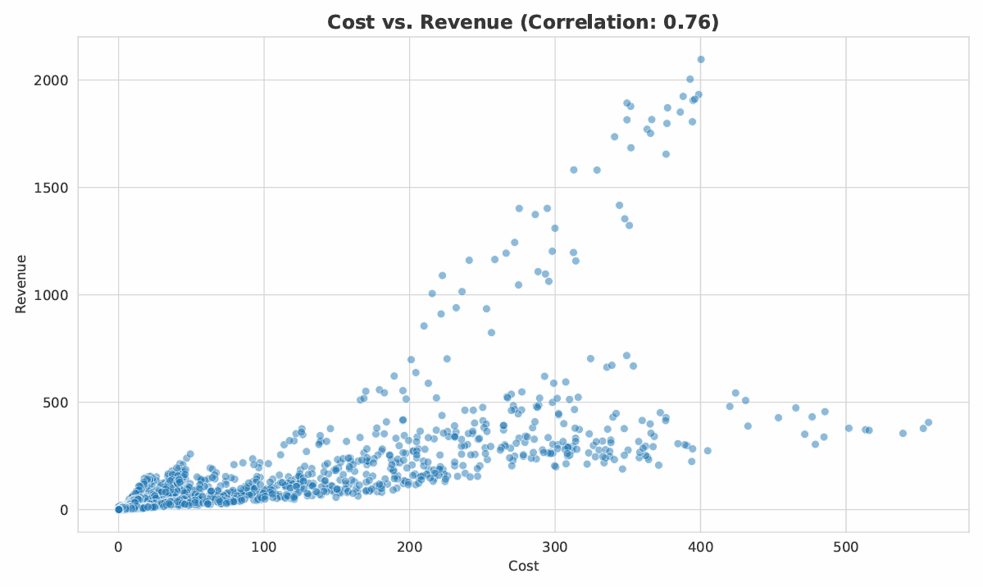
The Relationship Between Cost & Revenue
There is a strong positive correlation (0.76) between cost and revenue, meaning that an increase in advertising spend generally leads to an increase in revenue.

Slide 8
Analytical Approach & Techniques
A disciplined, multi-step process was used to transform raw data into actionable strategy.
Data Cleaning & Preparation: Ensured data integrity and consistency.
Feature Engineering: Created new KPIs to measure performance accurately.
Exploratory Data Analysis (EDA): Used visualizations to uncover trends and patterns.
Correlation Analysis: Identified statistical relationships between key variables.
Synergy Scoring: Developed a custom model to rank ad combinations.
Data Cleaning & Preparation
A clean dataset is the foundation of reliable analysis. Our process ensured data integrity.
Date Consolidation: Combined month and day columns into a single datetime object for time-series analysis.
Data Type Correction: Converted columns like cost, revenue, and clicks to numeric types for accurate calculations.
Handling Missing Values: Inspected for and addressed any null or inconsistent entries to prevent errors in analysis.

Slide 9
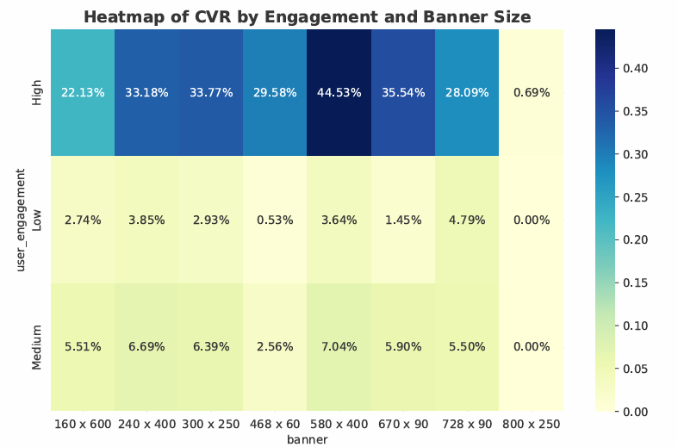
Feature Engineering Creating KPIs
We created new metrics to uncover deeper insights beyond the raw data.
CTR (Click-Through Rate): (clicks / displays)
CPC (Cost Per Click): (cost / clicks)
CVR (Conversion Rate): (conversions / clicks)
ROAS (Return on Ad Spend): (sales / cost)
Day of Week: Extracted the date to identify weekly performance trends
Technique: Correlation Analysis
Technique: A correlation heatmap was generated to visualize the linear relationships between numerical variables.
Insight: We observed strong positive correlations between clicks and revenue, and between cost and displays, which confirms expected relationships and validates data quality.

Slide 10
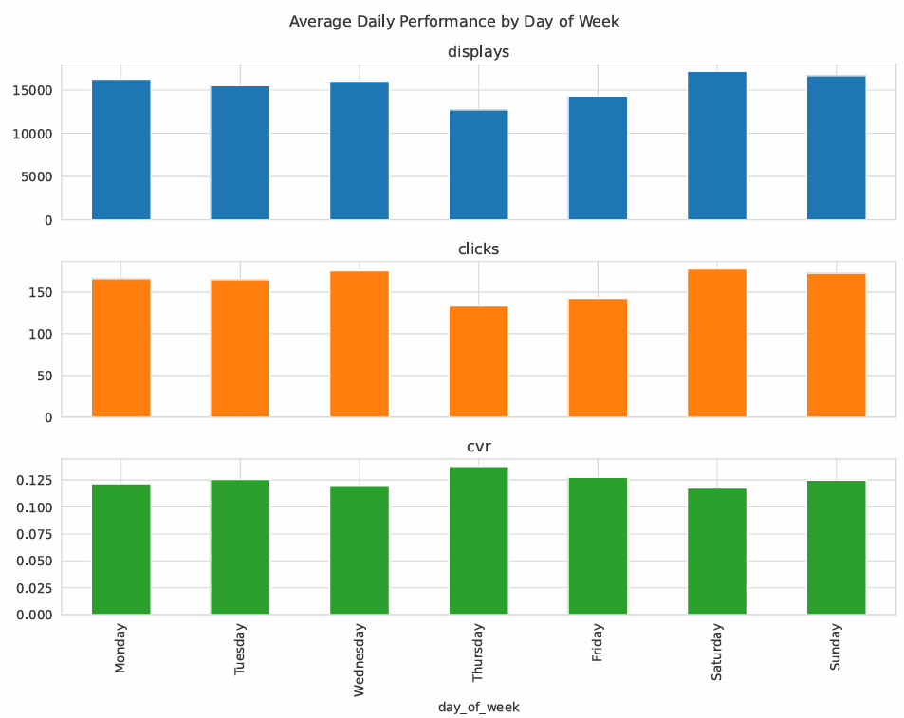
Daily Performance Trends
Core Insight: Performance is strongest from Tuesday to Thursday, suggesting a "mid-week conversion push" strategy could be effective.
Detailed Findings:
Clicks: Peak on Wednesdays.
Conversion Rate (CVR): Peaks on Thursdays.

Slide 11
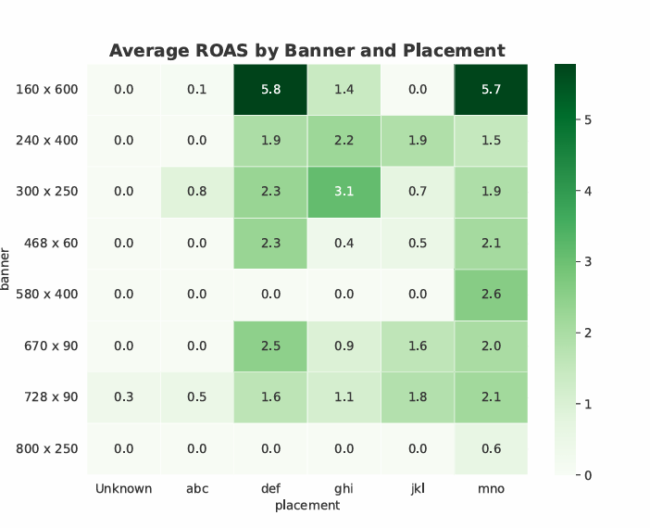
Synergy Score for Ad Combinations
Technique: A custom "Synergy Score" was developed to rank banner/placement combinations. The model weights key KPIs (ROAS, CVR, Clicks) to identify the most powerful pairs.
Synergy Score: A custom metric was created to identify high-potential banner/placement combinations.

Slide 12
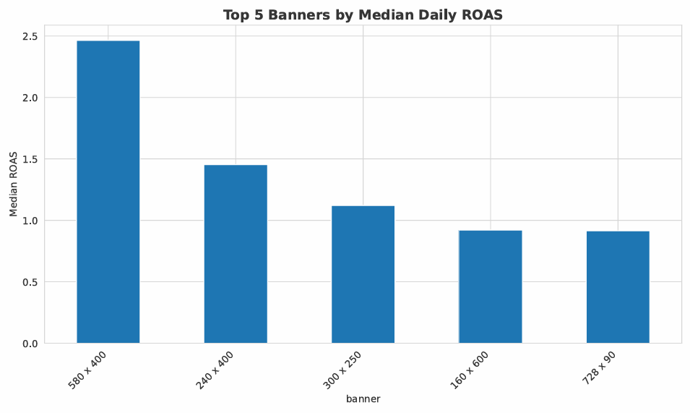
Synergy Score for Ad Combinations
Star Performer: The 300x250 banner on the ghi placement was identified as a top combination, delivering exceptional ROAS.
Action: We identified the top 5 banner/placement pairs that generate the highest overall return.
Formula: The score balances:
Return Per Click (RPC)
Conversion Rate (CVR)
Cost Per Click (CPC)

Slide 13
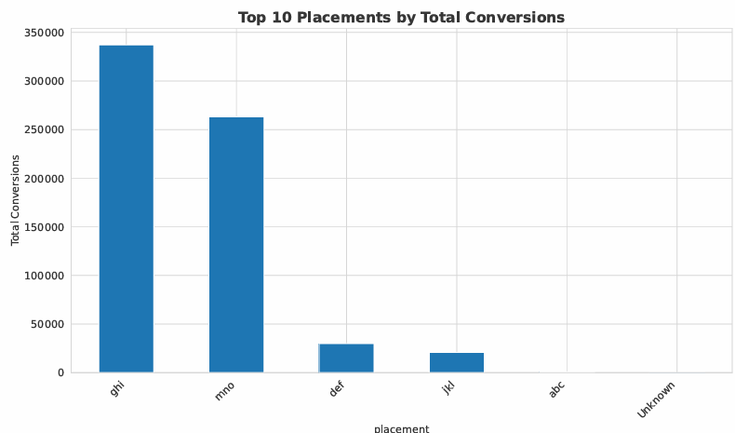
Synergy Score for Ad Combinations
Top Combinations:
580 x 400 on mno
300 x 250 on mno
300 x 250 on ghi

Slide 14
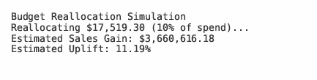
Budget Reallocation Simulation
Strategic Impact: A Budget Reallocation Simulation
Scenario: A simulation reallocated a 10% budget from the worst-performing ad combinations to the best.
Results:
Estimated Sales Uplift: 11.19%.
Estimated Sales Gain: Over $3.6 million.
Conclusion: Focusing on data-driven insights can lead to significant financial gains without increasing overall ad spend.

Slide 15
Results
Our analysis successfully identified the key levers for advertising performance.
1. Target High-Engagement Users: Focus budget and creative efforts on the "High" engagement segment.
2. Optimize Placements: Prioritize placements 'ghi' and 'mno' as they are top performers for volume and conversions.
3. Leverage Top Creatives: Ensure the 240x400 and 728x90 banners are active in campaigns to drive clicks. The 580x400 banner also shows consistent ROI.
4. Mid-Week Conversion Push: Consider increasing bids or promotions from Tuesday to Thursday to maximize results.

Slide 16
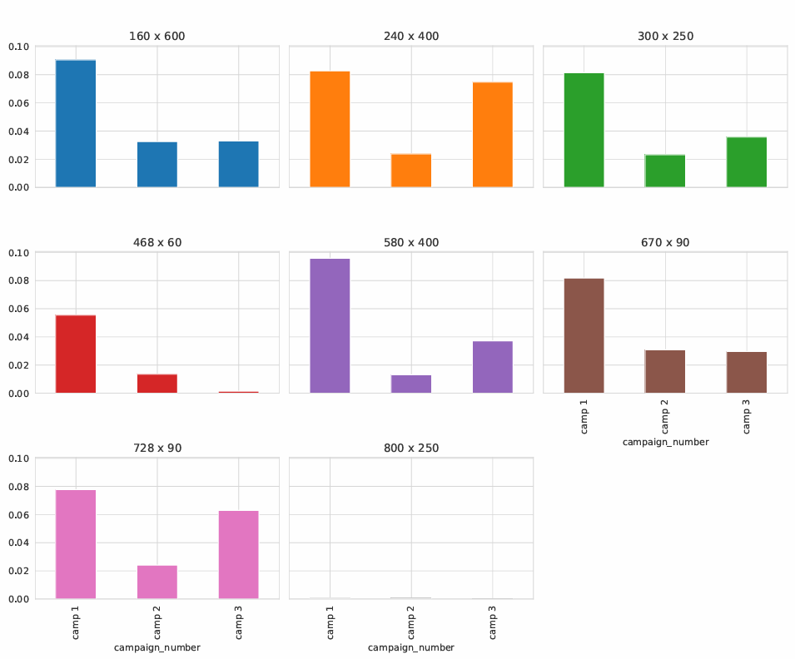
Results

Slide 17
Strategic Recommendations
Reallocate Budget: Shift spend towards high-engagement users and away from low-performing segments.
Optimize Placements & Creatives: Double down on what works—'ghi', 'mno', and the top-performing banner/placement combinations.
Launch Mid-Week Conversion Campaigns: Use promotions and increased bids to maximize results during peak CVR days.
A/B Test: Formally test the high-potential ad combinations identified in this analysis to validate their performance.

Slide 18
Thank you
max growth
By
Shaik Riyaz
www.linkedin.com/in/shaik-riyaz-761545251

